Slide 1
Causal Machine Learning
DSCI-D 590 : Biomedical Data Science In Practice
Final Presentation - Project Group 4
Madhumathi Sekar
Priyanka Prem Kumar
Madhuri Patibandla

Slide 2





TEAM MEMBERS
Priyanka Prem Kumar
Madhumathi Sekar
Madhuri Patibandla
prpremk@iu.edu
msekar@iu.edu
mpatiba@iu.edu

Slide 3
Team Members Contributions
Priyanka Prem Kumar | Standard Logistic regression, Feature Importance - Odd Ratios Logistic regression with Lasso Regularization
Madhumathi Sekar | Traditional Analysis - Kaplan-Meier Survival Analysis Cox Proportional Hazards model
Madhuri Patibandla | Targeted Maximum Likelihood Estimation, Causal Forest DML and Propensity Model and with Tuning, Comparing Traditional vs Causal ML Methods

Slide 4
Background
Immune checkpoint inhibitors (ICIs) have transformed cancer treatment.
ICIs work by blocking immune-inhibitory pathways.
ICIs can cause immune-related adverse events (irAEs) and notably acute kidney injury (ICI-AKI).
ICI-AKI leads to treatment delays, increased healthcare use, and worsened clinical outcomes.
The causal mechanisms and individual susceptibility remain poorly understood in prior studies.
Leverage rich, multidimensional data, enabling more nuanced investigation of clinical and non-clinical contributors to AKI risk.
Multidimensional Datasets: Phenotype, Visit Occurrence, Comorbidities, social determinants of health, Insurance.

Slide 5
Introduction
Traditional Statistical Analysis:
Standard Logistic regression
Feature Importance - Odd Ratios
Logistic regression with Regularization
Kaplan-Meier Survival Analysis
Cox Proportional Hazards Model
Causal Machine Learning
Targeted maximum Likelihood Estimation
Propensity Score Matching and Inverse Probability Weighting
Causal forest DML
Propensity Score Matching with Tuning
Comparison between Traditional Regression and Causal ML

Slide 6
EDA
Performed EDA on integrated dataset (phenotype, visits, comorbidities, insurance, SDOH)
High missingness in visit data; imputed as no visits
Binary variables with missing values assumed to indicate absence
Minimal missingness in demographics; imputed appropriately
Missing comorbidities treated as absence of diagnosis
Categorical variables one-hot encoded for modeling
Analyzed patterns in demographics, healthcare use, and comorbidity burden

Slide 7
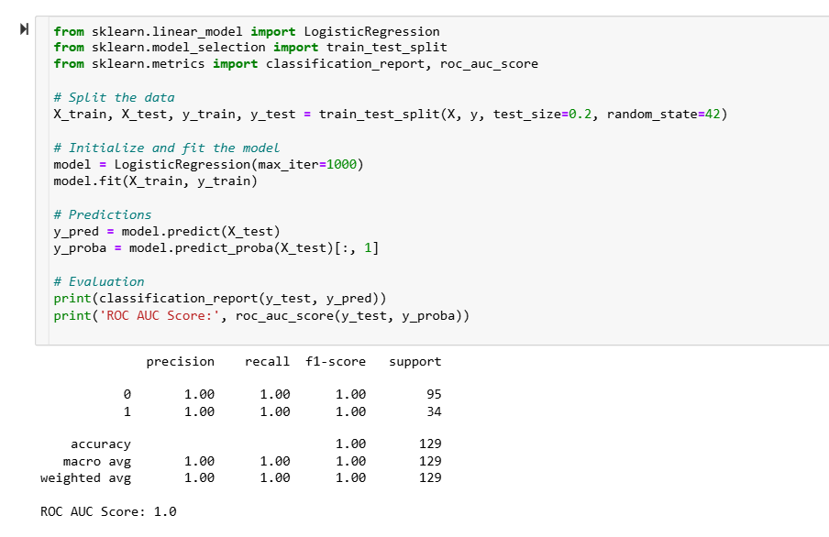
Standard Logistic Regression
Data split: 80% training / 20% testing
Model: Logistic regression with increased iterations to ensure convergence
Prediction: Model generated class labels and probabilities on the test set
Performance: Achieved 100% accuracy, precision, recall, F1-score, and ROC AUC
Interpretation: Perfect classification—no false positives or false negatives
Caution: Such flawless results are rare in clinical data
Risks: May indicate overfitting or data leakage
Small sample risk: Results may be unstable due to small, imbalanced dataset

Slide 8
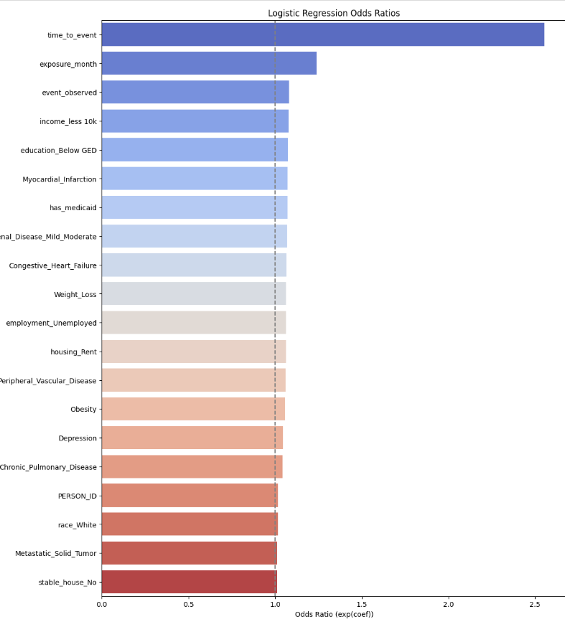
Feature Importance
Top 15 features identified span both clinical and social risk factors for ICI-AKI
Time-to-event was the strongest predictor—longer treatment duration linked to higher risk
Other timing variables (e.g., exposure month) also showed positive associations
Socioeconomic disadvantage (low income, limited education) increased AKI risk, likely via reduced access to care
Comorbidities like myocardial infarction, heart failure, renal disease, obesity, weight loss, and depression were key contributors
Insurance type, unemployment, and renting reflected structural vulnerabilities impacting outcomes
All top features had odds ratios > 1, indicating a positive association with AKI risk

Slide 9
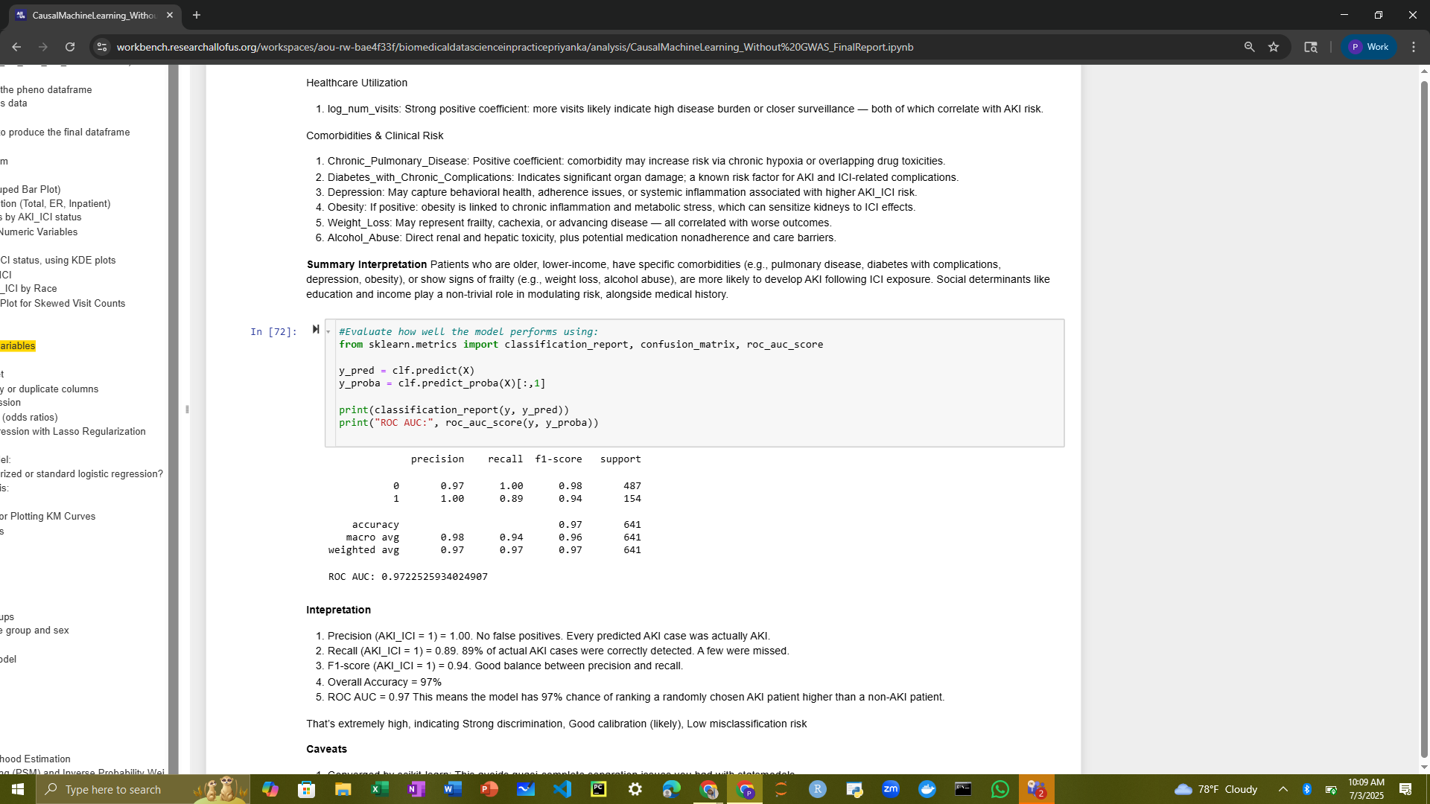
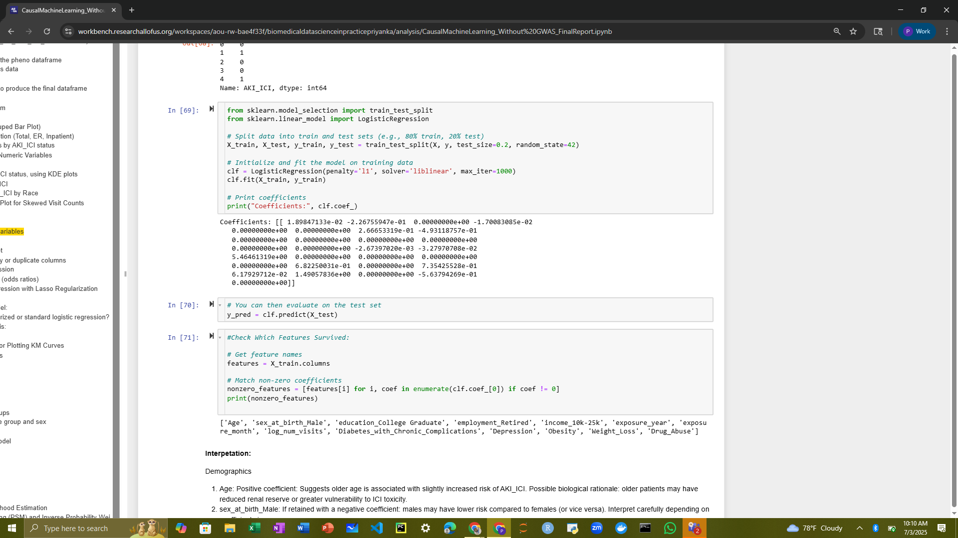
Regularized Logistic Regression
Key Predictors of ICI-AKI Risk
Older age – Higher risk likely due to reduced kidney reserve or treatment sensitivity
Male sex – Potentially lower risk than females (interpret with caution)
Higher education – Protective, possibly due to better health literacy or care access
Lower income – Higher risk, reflecting socioeconomic vulnerability
Retirement – Associated with increased risk, possibly linked to age or comorbidity burden
ICI timing – Exposure month/year may reflect changing practices or systemic disruptions
Healthcare utilization – More visits (log_num_visits) linked to higher risk, likely due to illness severity
High-Risk Comorbidities:
Chronic pulmonary disease – May raise risk via hypoxia or drug interactions,
Diabetes with complications – Indicates existing organ damage,
Depression – Related to systemic inflammation or adherence issues,
Obesity – Tied to inflammation and metabolic stress,
Weight loss – Suggests frailty or advanced disease,
Alcohol abuse – Direct toxicity and potential care barriers

Slide 10
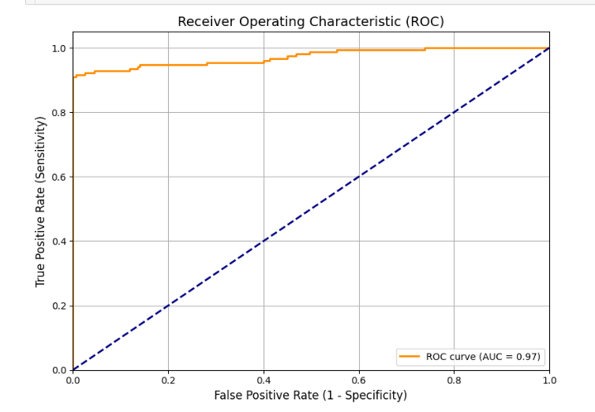
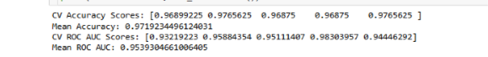
ROC and Cross Validation
ROC Curve: AUC of 0.97, with the curve near the top-left corner, shows excellent discrimination between AKI and non-AKI cases.
Cross-Validation: 5-fold CV yielded a mean accuracy of 97.2% and mean AUC of 0.95, confirming strong, consistent model performance.

Slide 11
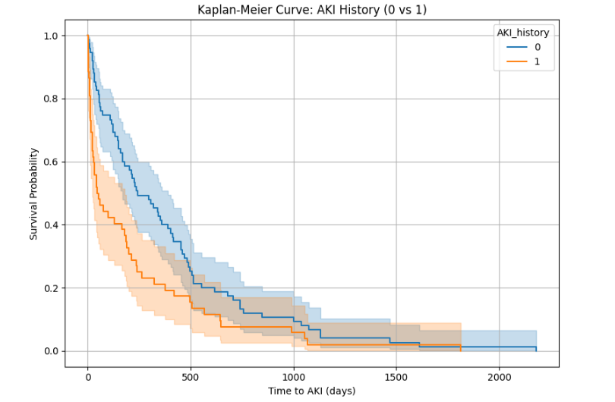
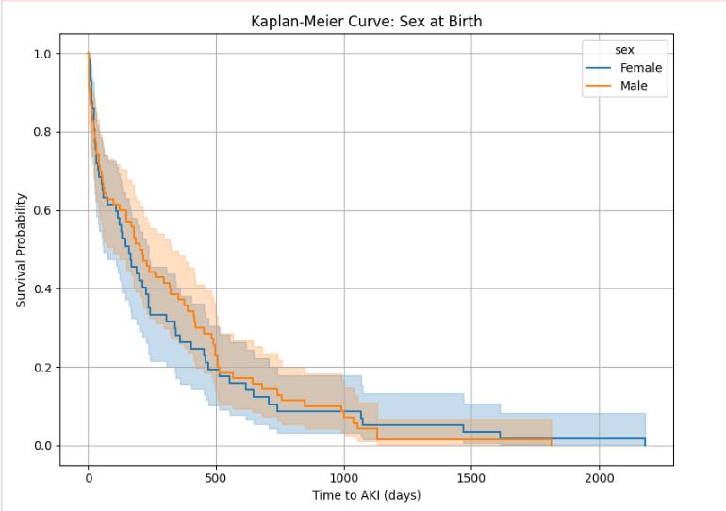
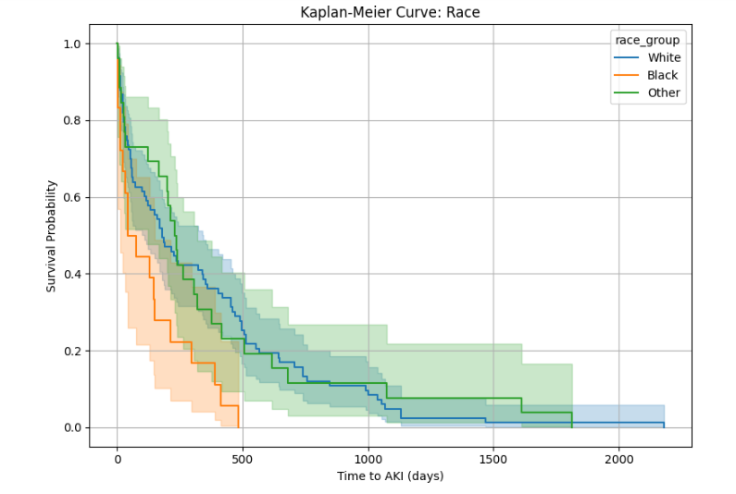
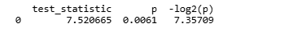
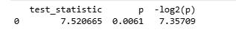
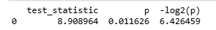
Kaplan-Meier Analysis
AKI History Sex Race
Log-Test Results Log-Test Results Log-Test Results

Slide 12
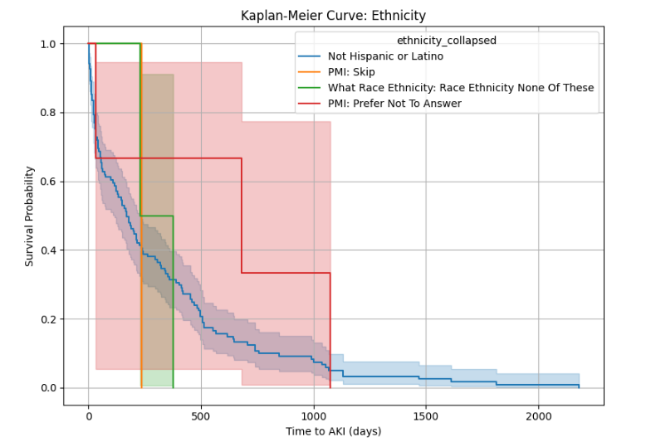
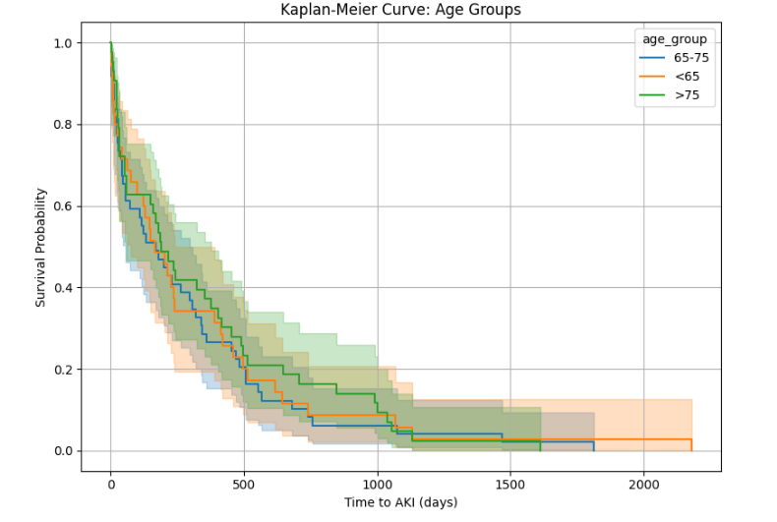
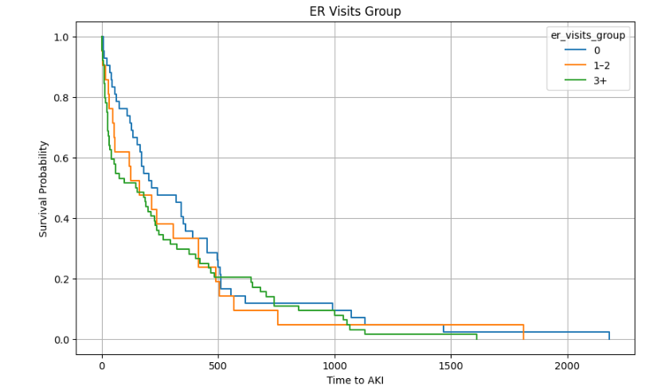
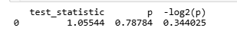
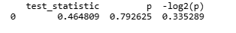
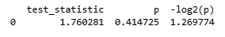
Kaplan-Meier Analysis
Ethnicity Age ER Visit
Log-Test Results Log-Test Results Log-Test Results

Slide 13
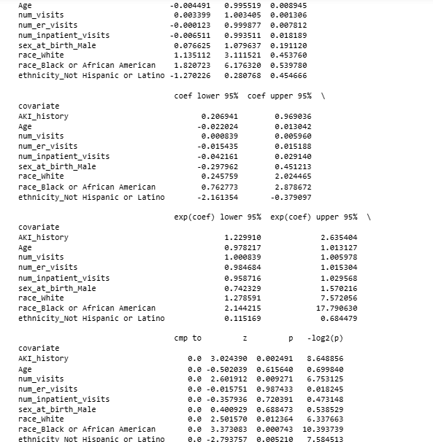
Cox Proportional Hazards Model
People who had AKI in the past were about 80% more likely to get it again, even when we consider other factors like age, race, and number of doctor visits.
Having more doctor visits was also linked to a slightly higher chance of getting AKI.
Age, ER visits, and hospital stays did not show a strong effect on AKI risk in this analysis.
People who were Not Hispanic or Latino had a lower risk of getting AKI.
People who were Black or African American had a much higher risk of getting AKI.
Although earlier analysis (Kaplan-Meier) suggested males may have higher risk, this more advanced model shows that sex was not a significant factor after adjusting for other variables.
The model’s ability to predict who gets AKI was moderate, with a score of 0.63.
KM might show higher AKI rates in males. But the Cox model could show that after adjusting for race, age, and visits, sex doesn’t matter — it's just confounded.

Slide 14
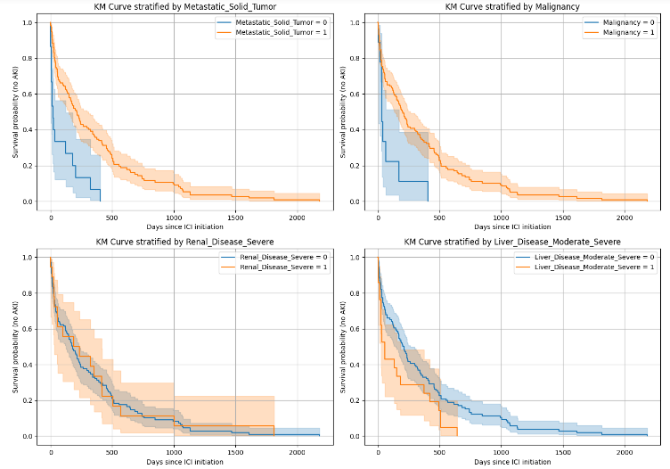
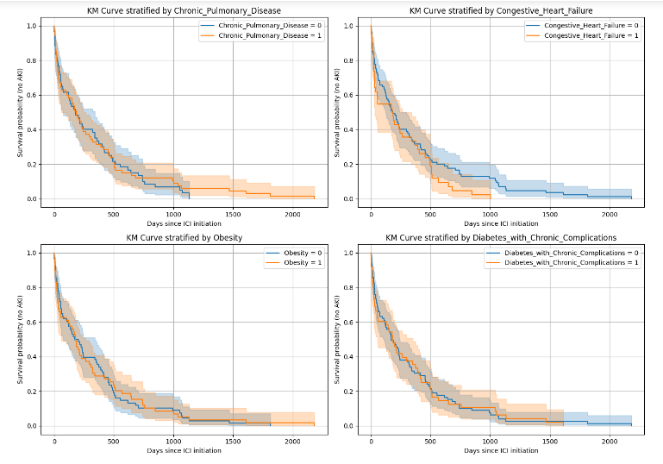
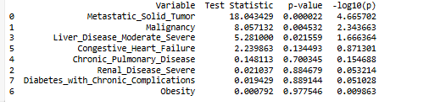
Kaplan-Meier Analysis
Comborbidity Groups
Log-Test Results

Slide 15
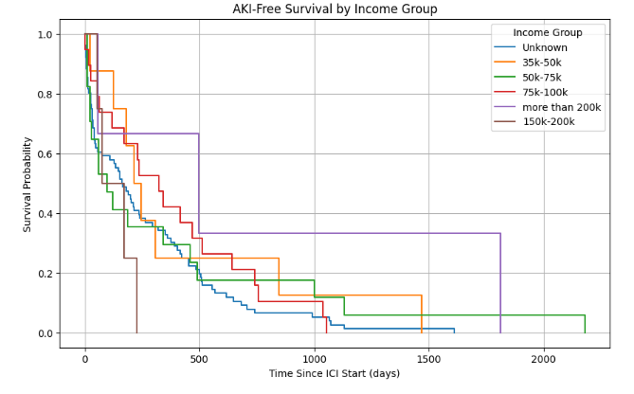
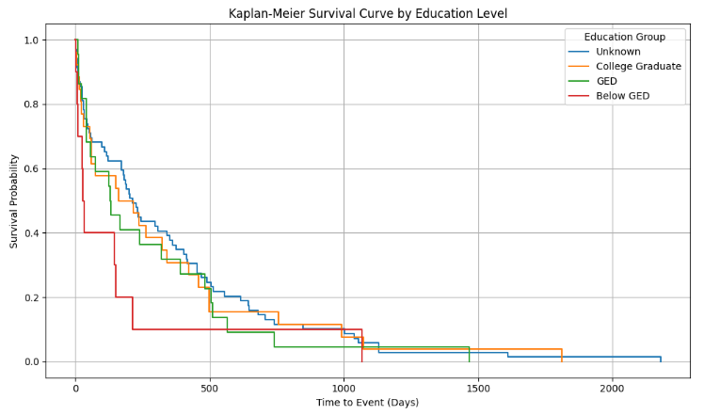
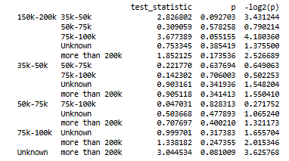
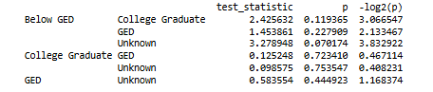
Kaplan-Meier Analysis
Income Education Level
Log-Test Results Log-Test Results

Slide 16
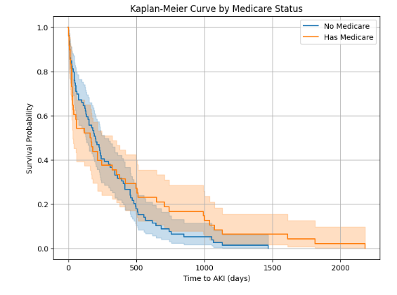
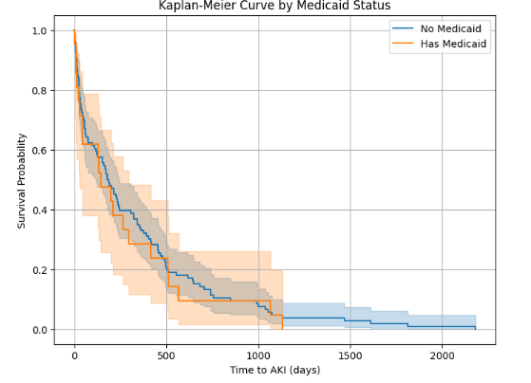
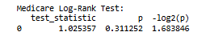
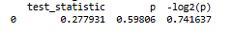
Kaplan-Meier Analysis
Insurance-Medicare Insurance-Medicaid
Log-Test Results Log-Test Results

Slide 17
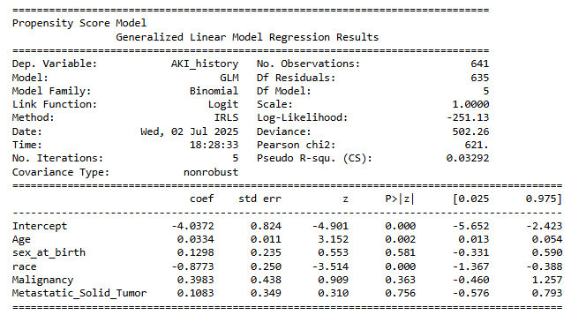
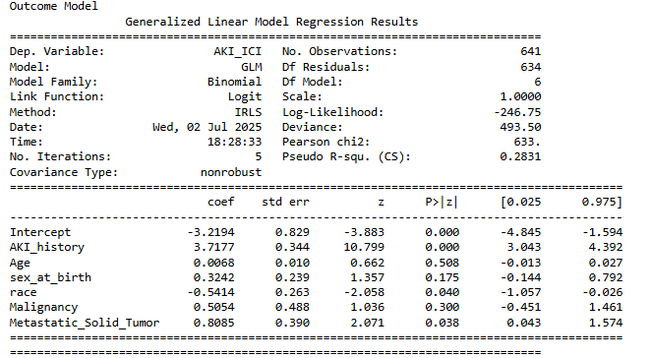
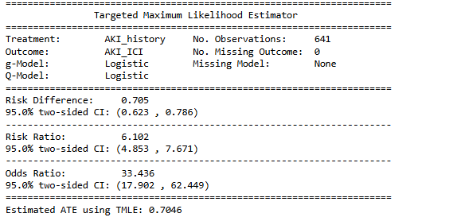
Causal Machine Learning
Targeted Maximum Likelihood Estimation:

Slide 18
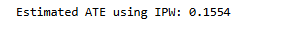
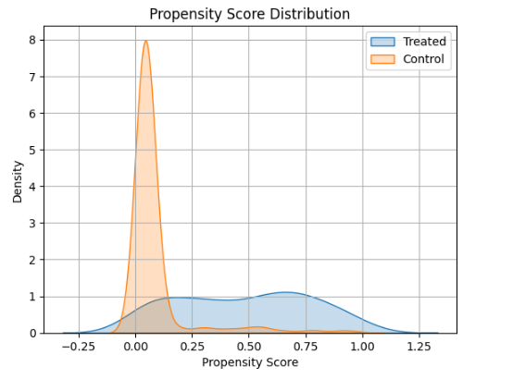
Propensity Score Matching and Inverse Probability Weighting:
.
PSM : the treatment group’s average result was about 0.033 higher than the control group’s. Base on the PSM scoring says treatment seems to have a small positive effect.
IPW : IPW method shows that the treatment seems to increase the outcome by about 0.155 on average.
Propensity score distribution :
There is limited overlap between the two groups’ propensity scores, especially at higher scores, which suggests that some treated individuals have very different characteristics from the controls

Slide 19
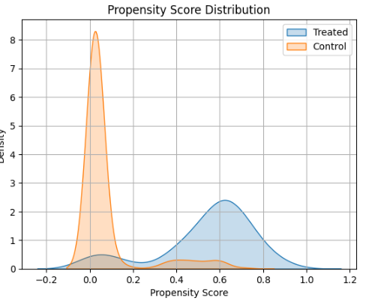
Propensity Score Matching with Tuning:
There is limited overlap between the two distributions, which may cause issues for treatment effect estimation due to poor covariate balance.

Slide 20
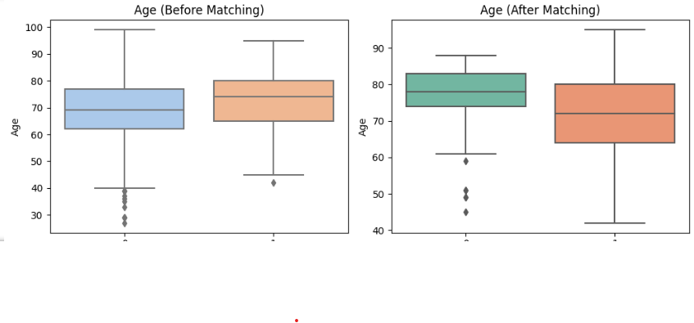
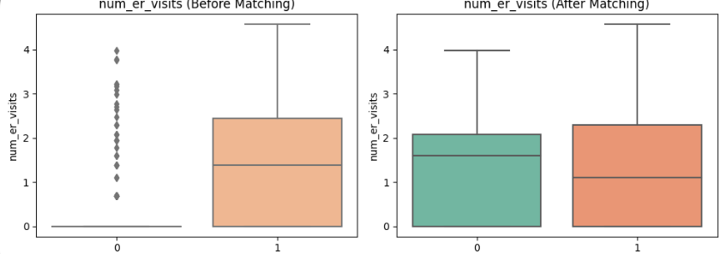
Age and num of er visits Before and After matching Based on Propensity ML with Tuning:

Slide 21
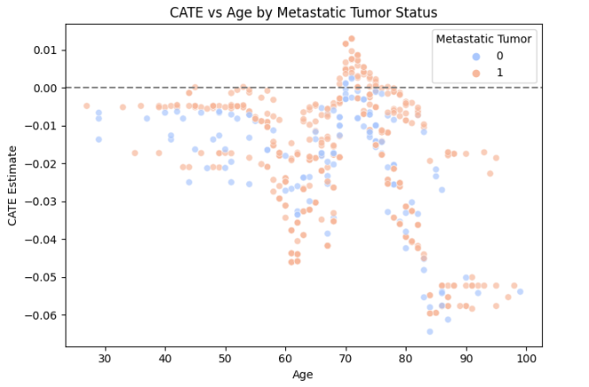
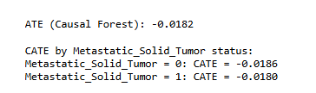
Causal Forecast DML

Slide 22
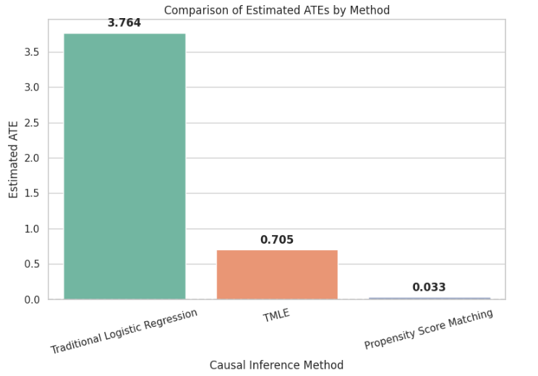
CONCLUSION :
Comparison of the results from Traditional Regression and Causal ML.
Standard logistic regression estimated a large effect (ATE ≈ 3.76), but did not adjust for confounding, likely overestimating the true effect.
TMLE (ATE ≈ 0.70) provided a more accurate and generalizable estimate by adjusting for confounders in both treatment and outcome models.
Propensity Score Matching gave the most conservative estimate (ATE ≈ 0.03), suggesting the treatment effect may be minimal after adjustments.
Causal inference methods reveal that the strong association in standard regression may be misleading.
Key takeaway: Adjusting for confounders is essential, without it, effect estimates may be biased and unreliable.

Slide 23
Thank you!

